Slide 1
Jermyn Borough Council Meeting
1/16/20

Slide 2
Meeting Agenda
Call to Order
Pledge of Allegiance
Roll Call
Previous Meeting Minutes
Treasurer’s Report/Bills Payable
Correspondence
Public Comment
Official’s Reports
Reports of Commissions/Committees
Feral Cat Discussion
Refuse Ordinance
New Business
Adjournment

Slide 3
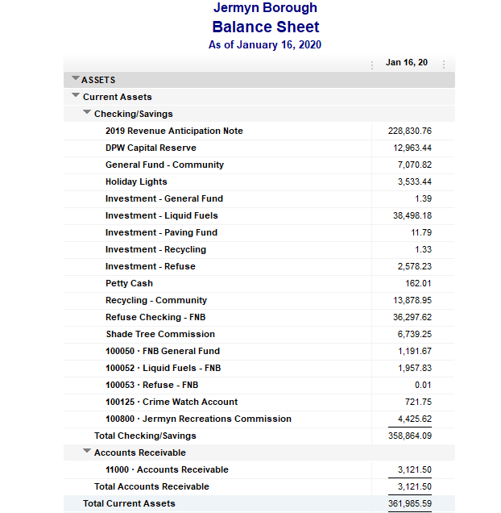
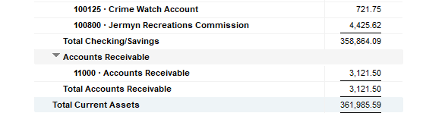
Treasurer’s report

Slide 4
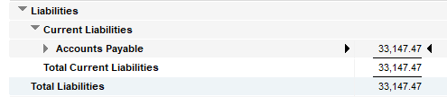
Treasurer’s report

Slide 5


Slide 6


